Slide 1
Thank You for Joining Us!
Series:
“The Year of Phenomenal Growth”

Slide 2
Scripture
When the cares of my heart are many, your consolations cheer my soul.” (Psalm 94:19, ESV)

Slide 3
He Will Comfort Me
Defeating Worry #6

Slide 4
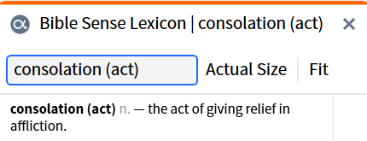
BSL Meaning of consolation

Slide 5
Point
God Yahweh promises to comfort us when we are facing anxiety and uncomfortable situations
As one whom his mother comforts, so I will comfort you; you shall be comforted in Jerusalem.” (Isaiah 66:13, ESV)

Slide 6
Point
2. He is a God that can provide comfort for any type of anxiety we might experience
2 Corinthians 1:3 (ESV)

Slide 7
Point
3. He is a God that provides comfort to us from anxiety when we sing, praise and worship him
And the ransomed of the Lord shall return and come to Zion with singing; everlasting joy shall be upon their heads; they shall obtain gladness and joy, and sorrow and sighing shall flee away.” (Isaiah 51:11, ESV)

Slide 8
WSDOT meaning of the word, Zion

Slide 9
REFLECTION
We must never forget that God Yahweh is always present to help relieve our anxieties and troubles when we approach him with a thankful and praising spirit.

Slide 10
WHOLE TITHE SUNDAY
December 15TH
Church Wide
Tithe Sunday

